Slide 1
Streamfeeder
https://github.com/cahillsf/streamfeeder

Slide 2
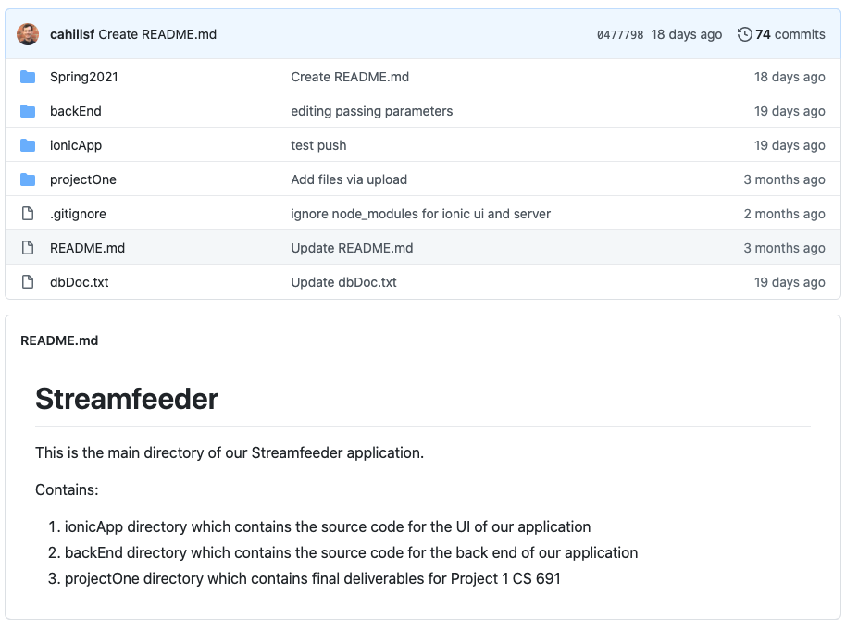
Repository Structure

Slide 3
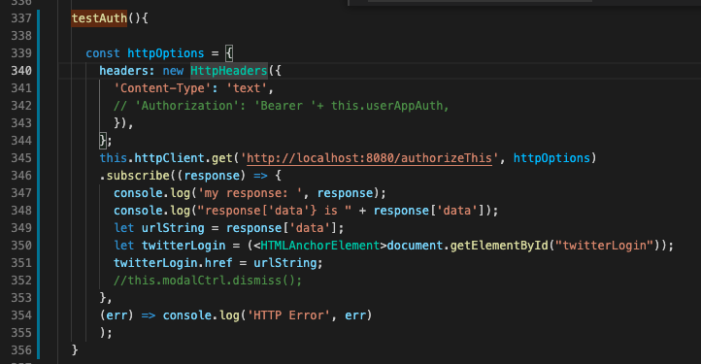
01.02 Ability to manage multiple social media accounts– Twitter login user auth – front-end

Slide 4
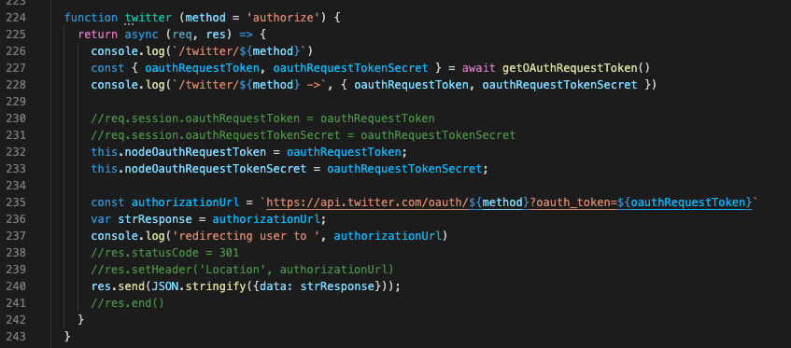
01.02 Ability to manage multiple social media accounts– Twitter login user auth – back end

Slide 5
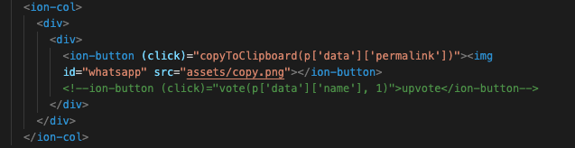
04.03 Easily copying link of desired post for sharing– HTML template

Slide 6
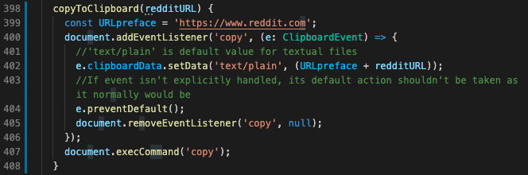
04.03 Easily copying link of desired post for sharing– TS function

Slide 7
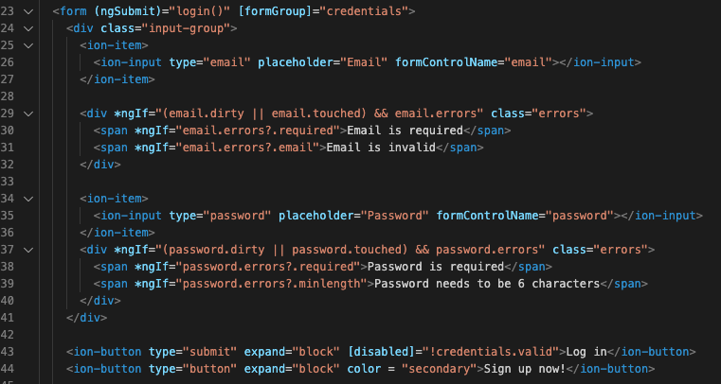
01.04 Create an account– HTML template

Slide 8
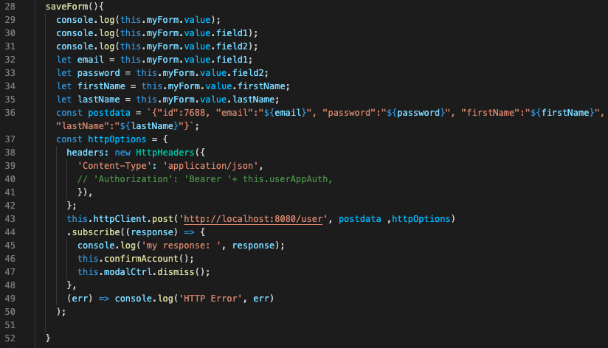
01.04 Create an account– Typescript functions to post form data

Slide 9
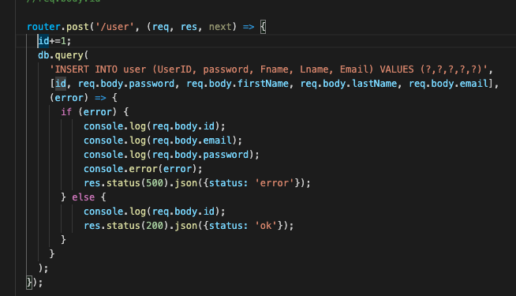
01.04 Create an account– node server inserting data into MySQL database

Slide 10
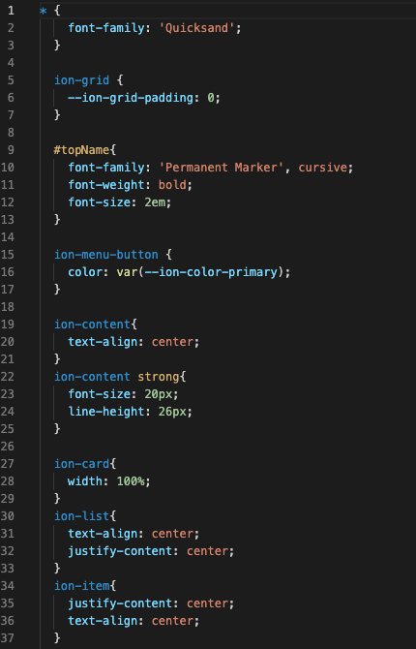
03.02 Page to view saved content– SCSS styling (snippet)

Slide 11
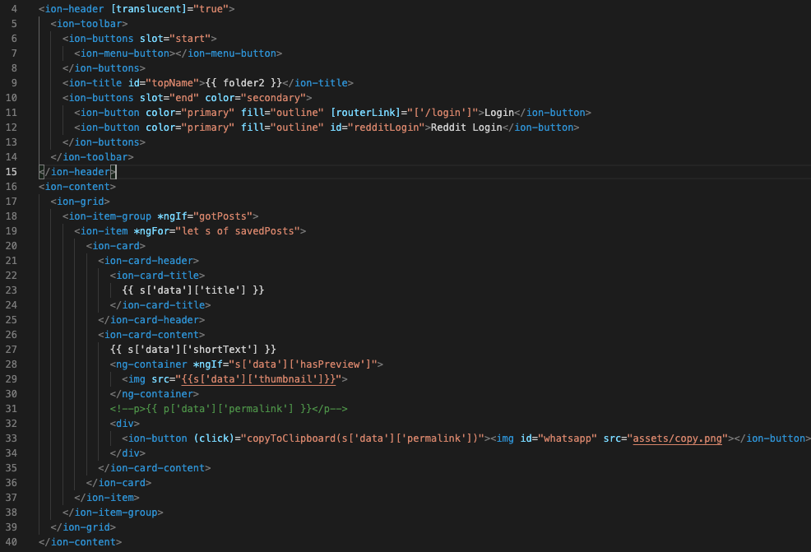
03.02 Page to view saved content– HTML template

Slide 12
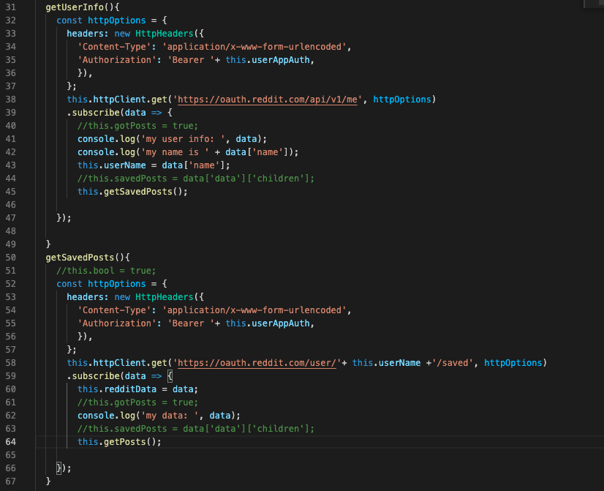
03.02 Page to view saved content– Typescript functions fetching data

Slide 13
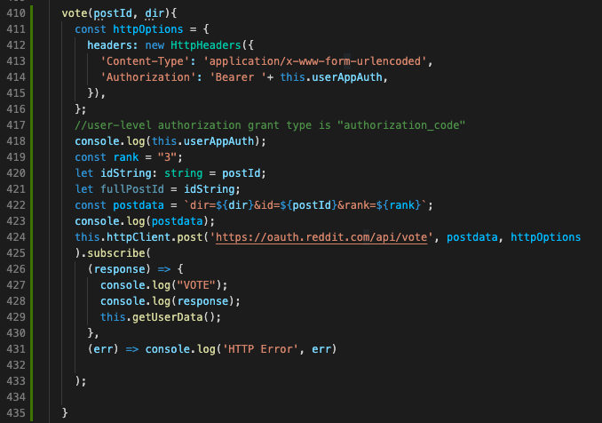
02.03 Like and dislike a post– Typescript function

Slide 14
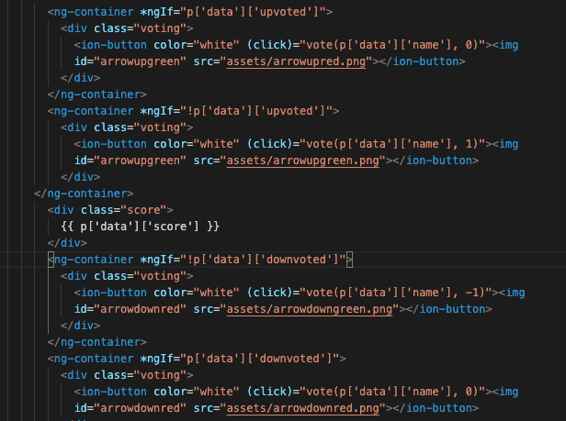
02.03 Like and dislike a post– HTML Template

Slide 15
Build and Deploy In Dev Environment (pt.1)
Node.js is required (download LTS version here https://nodejs.org/en/)
Ionic is required (run this shell command “npm install -g @ionic/cli”)
Clone the project repository
Front End Launch
cd into ionicApp directory
Install required node packages (run shell command “npm install”)
Launch dev server -> (run shell command ”ionic start”)
This command will open a tab in your default web browser to http://localhost:8100 where the development server is running

Slide 16
Build and Deploy In Dev Environment (pt.2)
MySQL application required (download here https://www.mysql.com/downloads/)
In your local MySQL application, create the following user for the application to access the database:
user: 'streamfeeder_admin'@'localhost’
password: tacosandburritos
Grant privileges to this user by running this command from your MySQL console “GRANT ALL PRIVELEGES ON streamfeeder.* to ‘streamfeeder_admin’@’localhost’”
Run the commands in streamfeeder/backEnd/database.sql in your MySQL application to create the necessary database and tables
cd into streamfeeder-server directory
Install required node packages (run shell command “npm install”)
Run command ”node src/index.js”

